Slide 1
Computer Vision

Slide 2
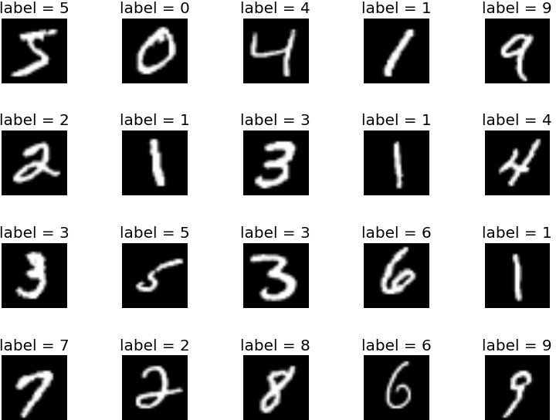
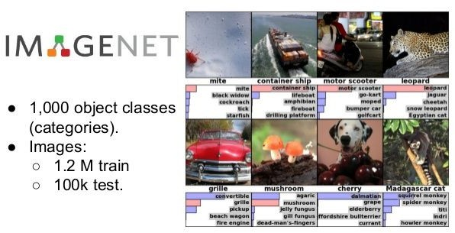
Standard Datasets for CV
1. Handwritten Digit Classification (LeNet - 1998)
input: a small single channel image
output: 10 outputs corresponding to the 10 digits 0-9. 60,000 training images, 10,000 test images
2. ImageNet Classification: The Annual World Cup for CV
input: colored image
output: 1000 outputs corresponding to the 1000 object classes in the dataset
1.2 M training images and 100,000 test images

Slide 3
Some Classical Networks
CNNs on MNIST
1. LeNet (1998)
10 way neural network classifier
Handwritten digits as an input
Tolerant of various transformations like rotation and scale
Was used by banks to recognize handwritten numbers on digitized checks
4 weight layers

Slide 4
Classical Networks
CNNs on ImageNet
AlexNet (2012)
First CNN to successfully be able to classify ImageNet images
Improved benchmark performance (top-5) on this image dataset from 26% to 15%
7 layers deep
2. ZF Net (2013)
Reduced the top-5 error rate to 11.2%
No major contributions
Also 7 layers deep
VGGNet (2014)
Simple and elegant
Reduced the top-5 error rate 7.2%
Did not win the competition, GoogleNet did!
6 layers deep

Slide 5
Classical Networks
CNNs on ImageNet
GoogleNet (2014)
2014 ImageNet winner with top-5 error rate of 6.7%
Used inception modules
22 layers deep and used side cost functions
ResNet (2015)
2015 ImageNet winner with top-5 error rate of 3.57
First truly deep network with 152 weight layers
CUImage (2016)
2016 ImageNet winner with top-5 error rate of 2.99
Ensemble approach, not very interesting
7. SENet (2017)
2016 ImageNet winner with top-5 error rate of 2.251
Work by Momenta
The last ImageNet challenge
Notes:
Please inform the learners that there are many networks but we will be discussing only some of these networks like VGG, ALEXNET and RESNET

Slide 6
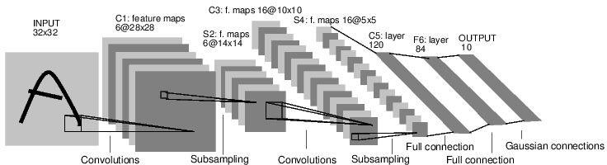
LeNet-5
[LeCun et al., 1998]
Conv filters were 5x5, applied at stride 1
Subsampling (Pooling) layers were 2x2 applied at stride 2
Architecture is [CONV-POOL-CONV-POOL-CONV-FC]
Source: Gradient Based Learning Applied to Document Recognition, LeCun et al. (1998)

Slide 7
AlexNet
[Krizhevsky et al., 2012]
96
Input Image
Conv + MaxPool
+ ReLU
Conv + MaxPool
+ ReLU
Conv + MaxPool
+ ReLU
Conv + MaxPool
+ ReLU
Output
Fully Connected
Fully Connected
Flatten
1000x
1

Slide 8
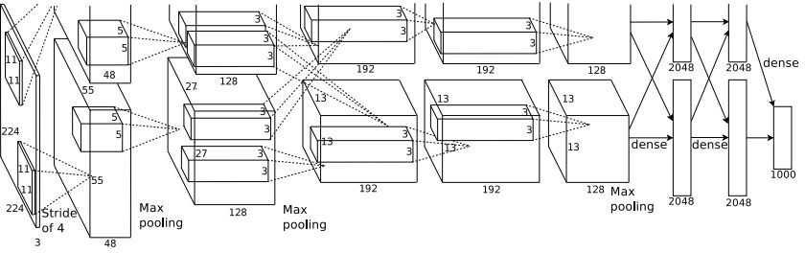
AlexNet
[Krizhevsky et al., 2012]
Input: 227x227x3 images
First layer (CONV1): 96 11x11 filters applied at stride 4
Output volume size? (Hint: (227-11)/4+1)
Sourced with permission from: ImageNet Classification with Deep Convolutional Neural Networks, Krizhevsky et al. (2012)

Slide 9
AlexNet
[Krizhevsky et al., 2012]
96
Input: 227x227x3 images
First layer (CONV1): 96 11x11 filters applied at stride 4
Output volume size: (227-11)/4+1 = 55 for each H and W, so 55x55x96
Sourced with permission from: ImageNet Classification with Deep Convolutional Neural Networks, Krizhevsky et al. (2012)

Slide 10
AlexNet
[Krizhevsky et al., 2012]
96
Input: 227x227x3 images
First layer (CONV1): 96 11x11 filters applied at stride 4
Output volume size: 55x55x96
Total number of parameters?
Sourced with permission from: ImageNet Classification with Deep Convolutional Neural Networks, Krizhevsky et al. (2012)

Slide 11
AlexNet
[Krizhevsky et al., 2012]
96
Input: 227x227x3 images
First layer (CONV1): 96 11x11 filters applied at stride 4
Output volume size: 55x55x96
Total number of parameters: 11*11*3*(96) = 35K
Sourced with permission from: ImageNet Classification with Deep Convolutional Neural Networks, Krizhevsky et al. (2012)

Slide 12
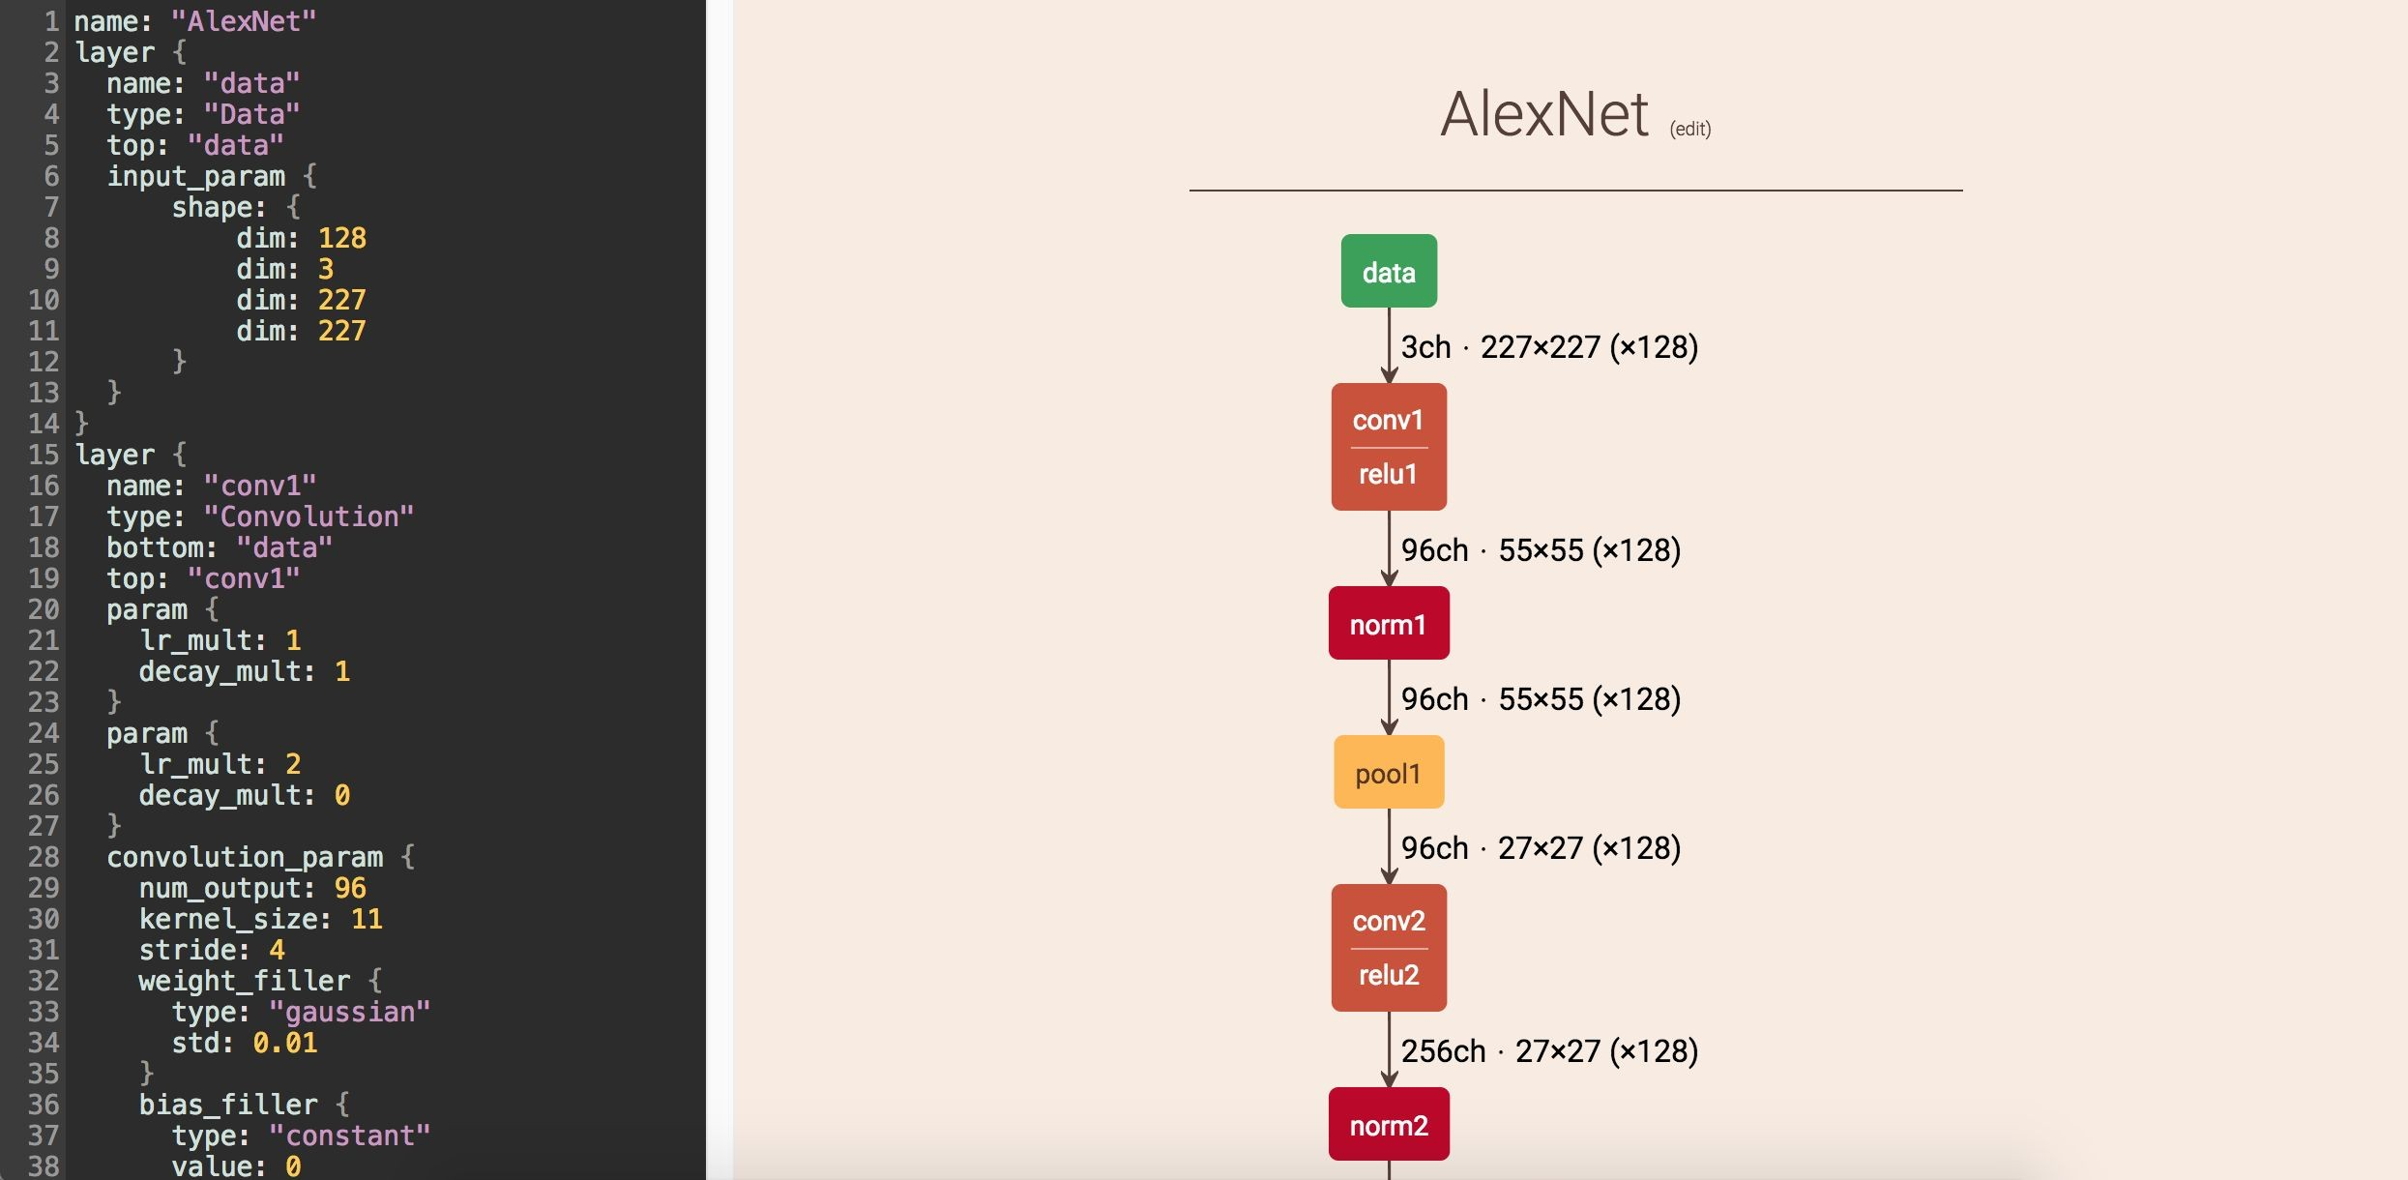
A tool to analyze deep networks
https://dgschwend.github.io/netscope/quickstart.html
Notes:
Please show this link to the learners

Slide 13
VGGNet
[Simonyan and Zisserman, 2014]
Softmax
This model used:
Softmax
FC 1000
FC 4096
FC 4096
Smaller filters
But
Deeper networks
FC 1000
FC 4096
FC 4096
Pool
Pool
3*3 CONV 512
3*3 CONV 512
3*3 CONV 512
3*3 CONV 512
3*3 CONV 512
3*3 CONV 512
3*3 CONV 512
3x3 CONV stride 1, pad 1 2x2 MAX POOL stride 2
Pool
Pool
3*3 CONV 512
3*3 CONV 512
3*3 CONV 512
3*3 CONV 512
Pool
3*3 CONV 256
3*3 CONV 256
Softmax
3*3 CONV 512
3*3 CONV 512
3*3 CONV 512
FC 1000
FC 4096
FC 4096
Why use smaller filters? (3x3 conv)
Pool
3*3 CONV 256
3*3 CONV 256
Pool
3*3 CONV 256
3*3 CONV 384
Answer: Stack of three 3x3 conv (stride 1) layers has same effective receptive field as one 7x7 but deeper, more non-linearities and fewer parameters.
Pool
Pool
Pool
3*3 CONV 128
3*3 CONV 128
3*3 CONV 384
3*3 CONV 128
3*3 CONV 128
Pool
Pool
Pool
3*3 CONV 256 256256
3*3 CONV 64 64
3*3 CONV 64 64
3*3 CONV 96
3*3 CONV 64
3*3 CONV 64
Input
Input
Input
AlexNet

Slide 14
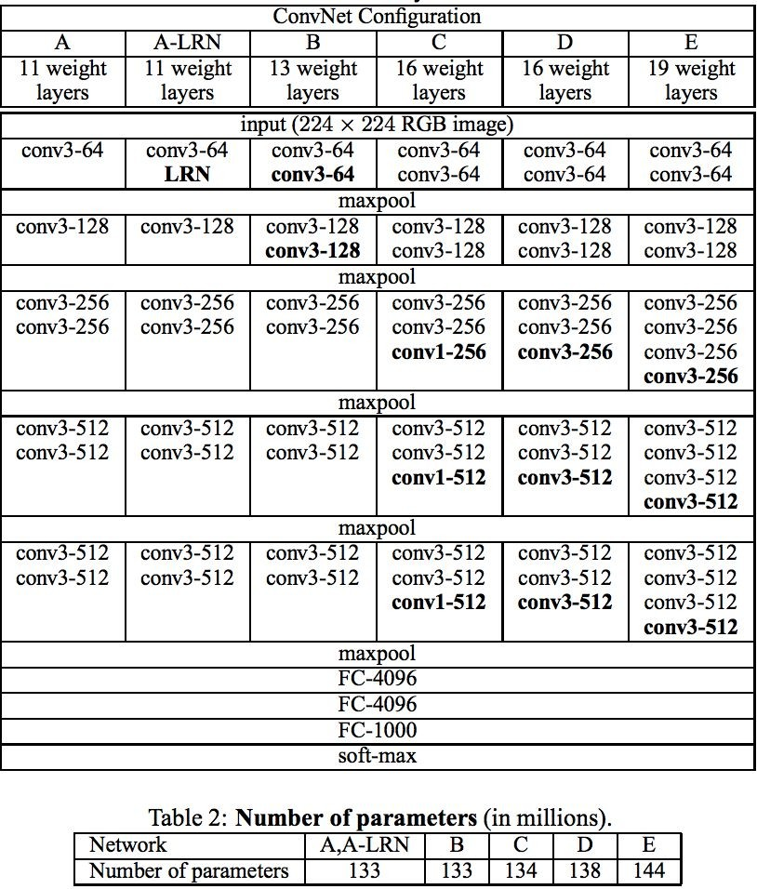

VGGNet
[Simonyan and Zisserman, 2014]
This model used:
Best performing model
Smaller filters
But
Deeper networks
3x3 CONV stride 1, pad 1 2x2 MAX POOL stride 2
Improved from 11.2% top 5 error
in ILSVRC 2013
To 7.3% top 5 error
Sourced with permission from: ‘Very deep
large-scale image recognition, Simonyan & Zisserman (2015)

Slide 15
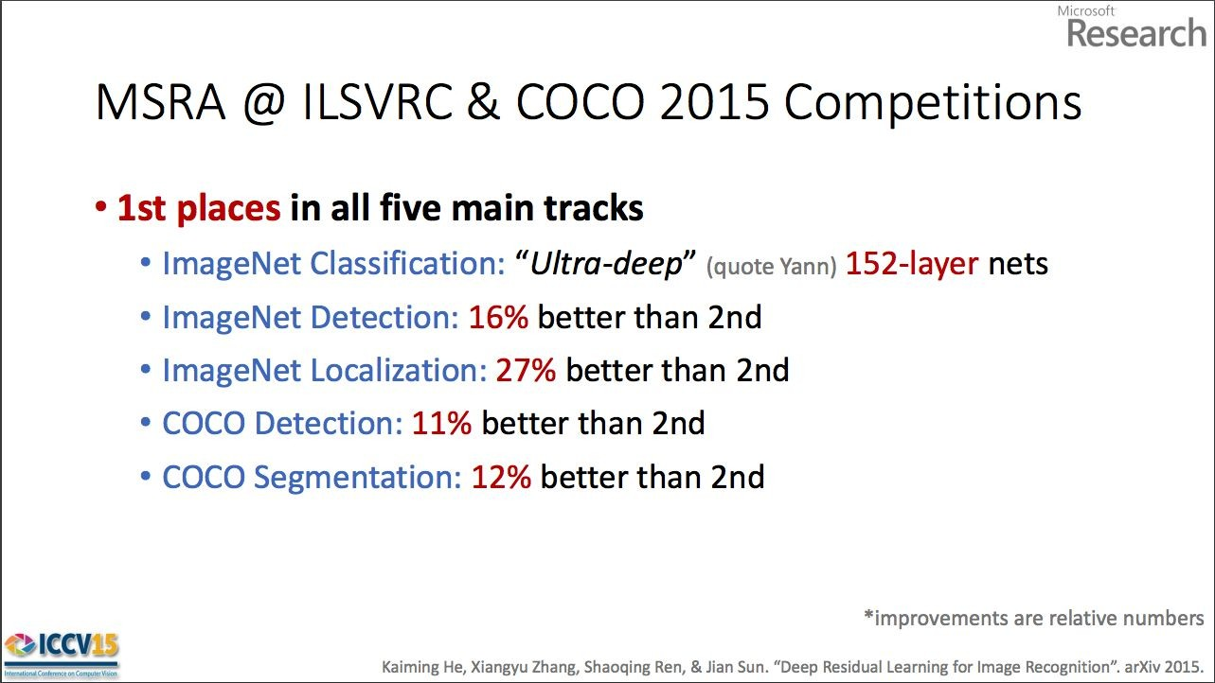
ResNet
[He et al., 2015]
Winner of ILSVRC 2015
3.6% top-5 error!

Slide 16
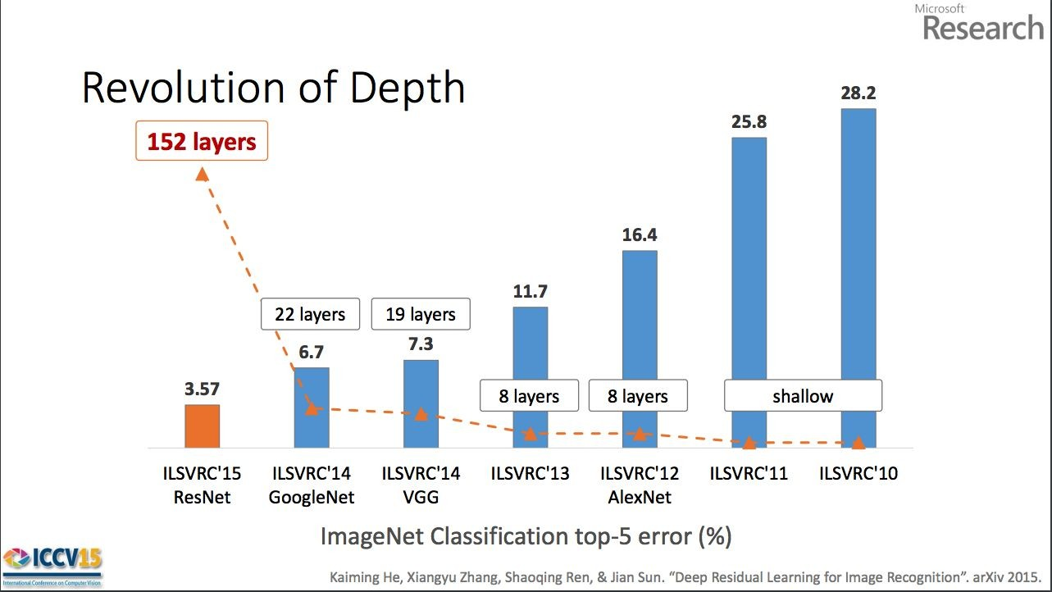
ResNet
[He et al., 2015]
Sourced with permission from: Deep Residual Learning for Image Recognition, Kaiming He (2015)
Pro

Slide 17
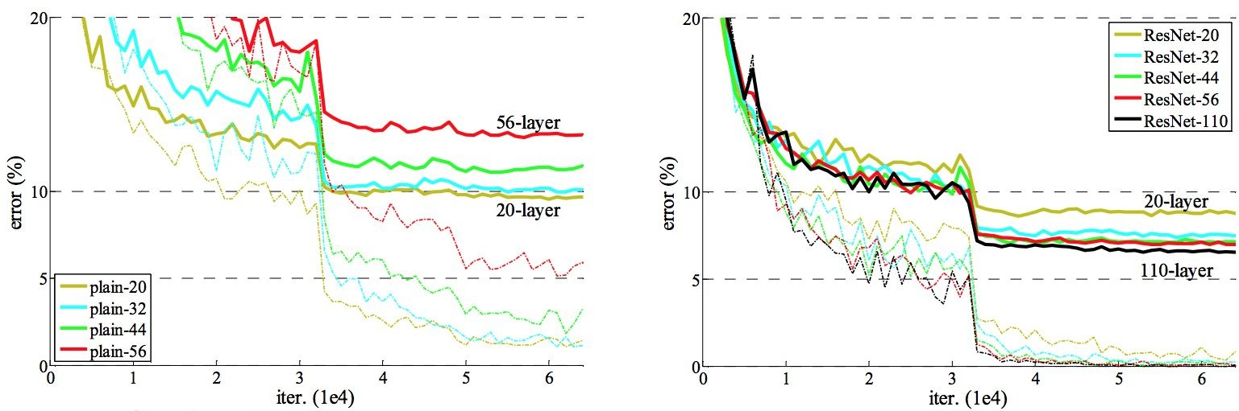
ResNet
[He et al., 2015]
Experiments on CIFAR-10
Plain Networks
Sourced with permission from: Deep Residual Learning for Image Recognition, Kaiming He (2015)
ResNets

Slide 18
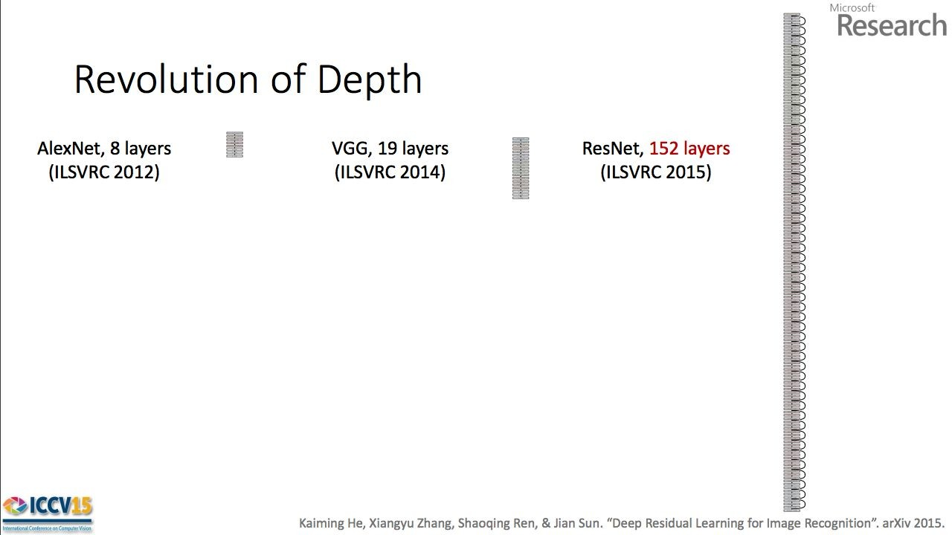
ResNet
[He et al., 2015]
2-3 weeks of training on 8 GPU machine At runtime: Faster than VGGNet
(even with 8x more layers)
•
•
Sourced with permission from: Deep Residual Learning for Image Recognition, Kaiming He (2015)

Slide 19
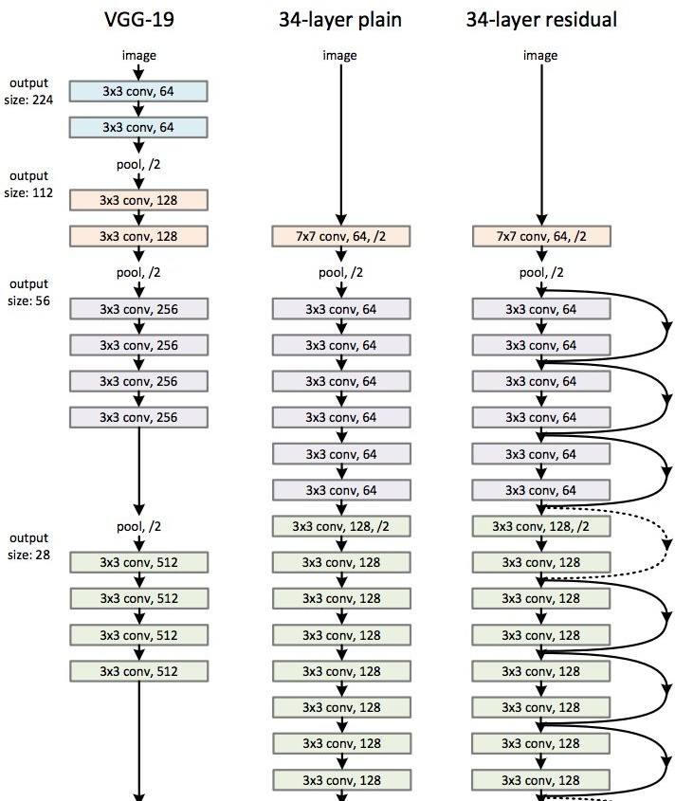
ResNet
[He et al., 2015]
224x224x3
56 x 56
spatial
dimension

Slide 20
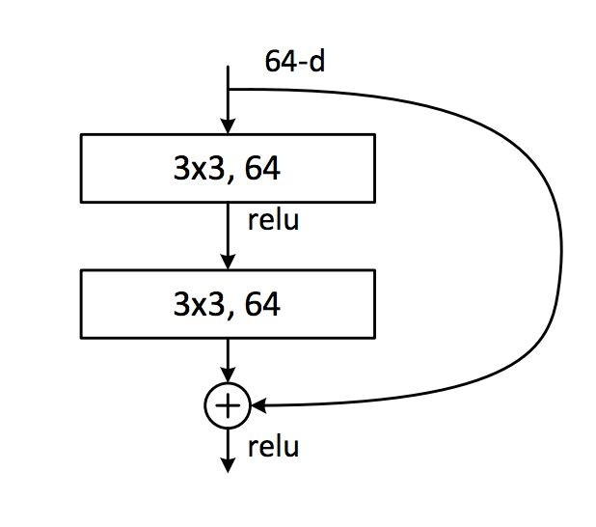



ResNet
[He et al., 2015]
x
x
Weight layer
 | relu
F(x)
entity x
(x) + x
Weight layer
 | relu
H(x)
H(x) = F
Plain Network
ResNet
Sourced with permission from: Deep Residual Learning for Image Recognition, Kaiming He (2015)

Slide 21
ResNet
[He et al., 2015]
Batch Normalization after every CONV layer
Xavier/2 initialization from He et al.
SGD + Momentum (0.9)
Learning rate: 0.1, divided by 10 when validation error plateaus
Mini-batch size 256
Weight decay of 1e-5
No dropout used

Slide 22
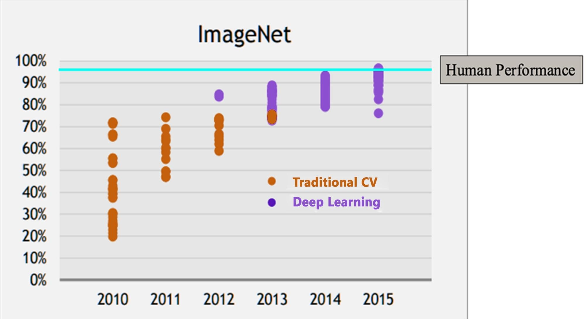
Why ConvNets?

Slide 23
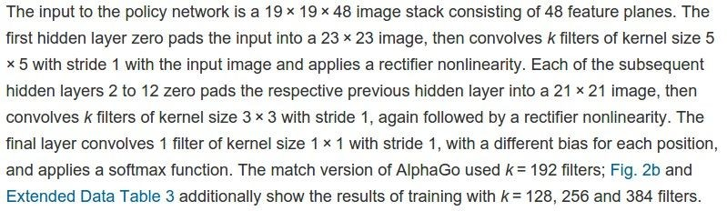
Google DeepMind: AlphaGo
Policy network:
INPUT: [19x19x48]
CONV1: 192 5x5 filters , stride 1, pad 2
CONV2..12: 192 3x3 filters, stride 1, pad
[19x19x192] [19x19x192]
CONV: 1 1x1 filter, stride 1, pad 0 [19x19] (probability map of promising moves)
Excerpt Source: ‘Mastering the game of Go without human knowledge’, Nature, David Silver et al. (2017)

Slide 24
Summary
ConvNets stack CONV, POOL, FC layers
Trend towards smaller filters and deeper architectures
Trend towards getting rid of POOL/FC layers (just CONV)
Typical architectures look like:
[(CONV-RELU)*N-POOL?]*M-(FC-RELU)*K-SOFTMAX
where N is usually up to ~5, M is large, 0 <= K <= 2.
But recent advances such as ResNet/GoogLeNet challenge this paradigm

Slide 25
Data Needs for ConvNets
“ConvNets need a lot of data to train”?
This is a myth
Fine Tuning
ConvNets usually not trained from scratch

Slide 26


Data Needs for ConvNets
Train once on massive data like ImageNet
Fine tune the network using your own (much smaller) data
ImageNet Data
Your data

Slide 27
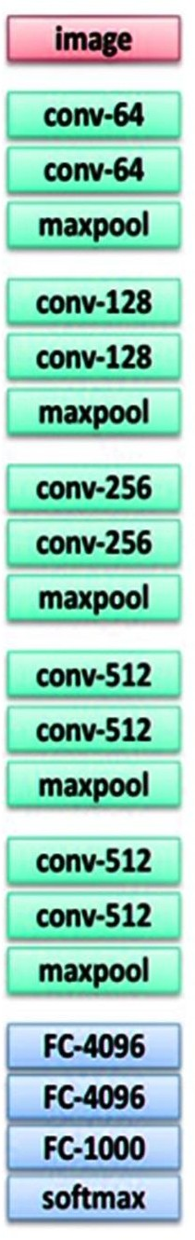
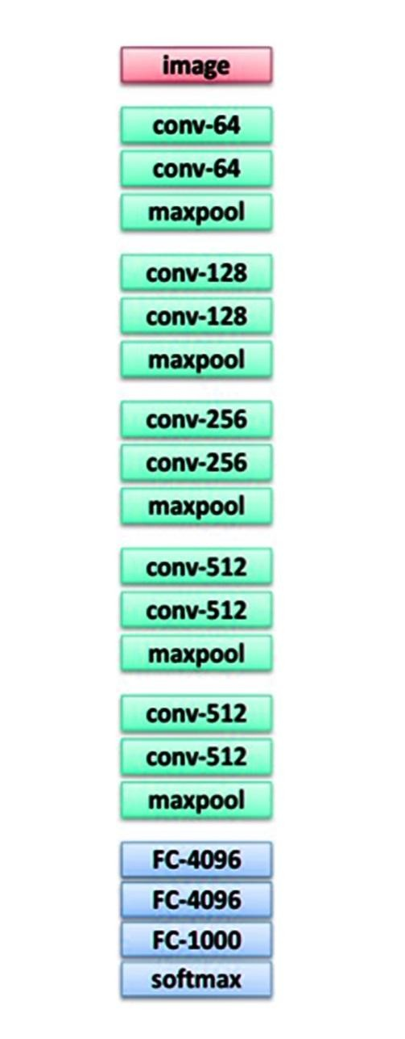
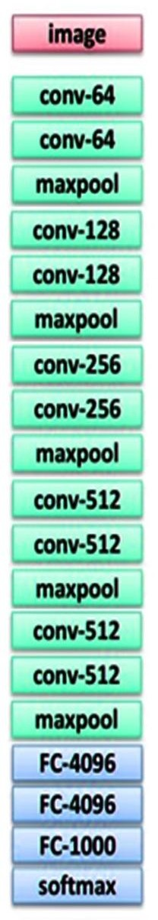
Transfer Learning with CNNs
1.
Train on ImageNet
2.
3.
If the dataset is medium sized, “fine-tune”.
Use the old weights as initialization, train the full network or only some of the higher layers
If you have a small dataset: fix all weights (treat CNN as fixed feature extractor), retrain only the classifier
Swap softmax layer at end
Retrain bigger portion of network

Slide 28

Transfer Learning with CNNs
1.
Train on ImageNet
2.
3.
Medium dataset:
Finetune
Small dataset:
Feature Extractor
Freeze
Train
Train

Slide 29
Transfer Learning with CNNs
Rule of thumb:
Use only ~1/10th of the original learning rate in fine tuning top layer
And ~1/100th in intermediate layers

Slide 30
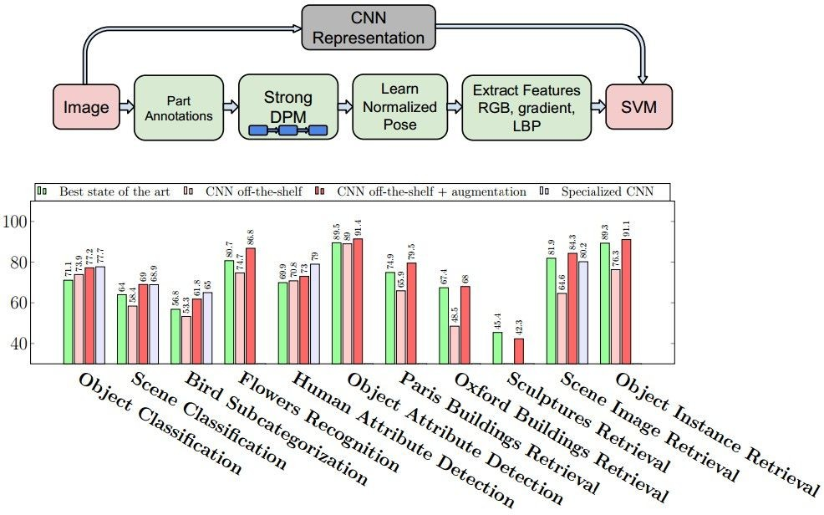
CNN Features off-the-shelf
[Razavian et al., 2014]
“Recent results indicate that the generic descriptors extracted from the convolutional neural networks are very powerful.”
Source: ‘CNN Features off-the-shelf: An Astounding Baseline for Recognition’, Razavian et al. (2014)

Slide 31
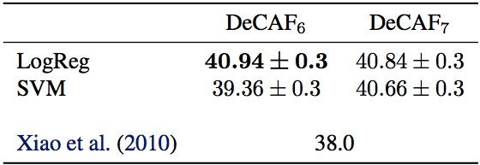
Deep Convolutional Activation for Generic Visual Recognition
[Donahue, Jia et al., 2013]

Slide 32
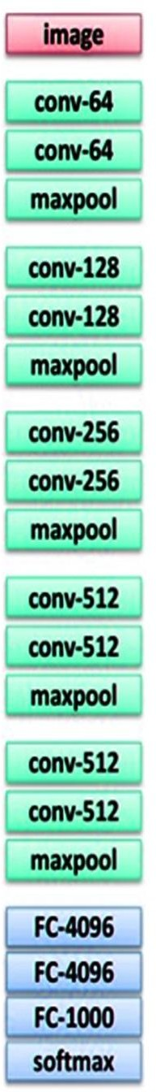



very similar dataset
very different dataset
very little data
?
?
more generic
quite a lot of data
?
?
more specific

Slide 33
very similar dataset
very different dataset
very little data
On the Top layer use Linear Classifier
?
more generic
quite a lot of data
Fine Tuning of few layers
?
more specific

Slide 34
very similar dataset
very different dataset
very little data
On the Top layer use Linear Classifier
Try linear classifier from different stages
more generic
Fine Tune a larger number of layers
quite a lot of data
Fine Tuning of few layers
more specific

Slide 35
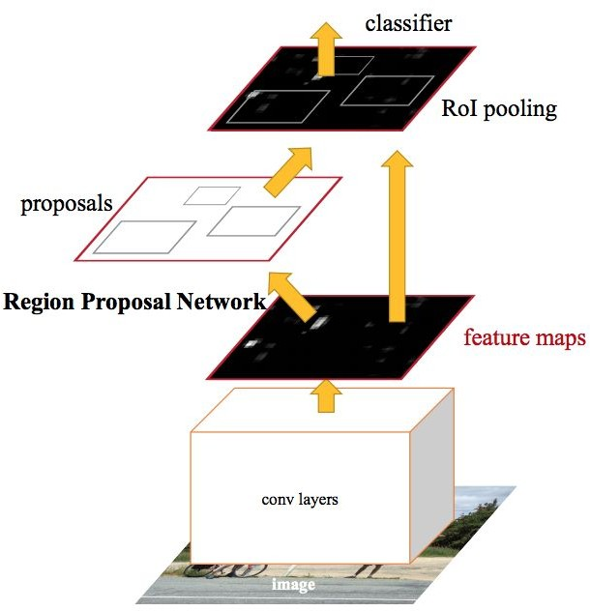
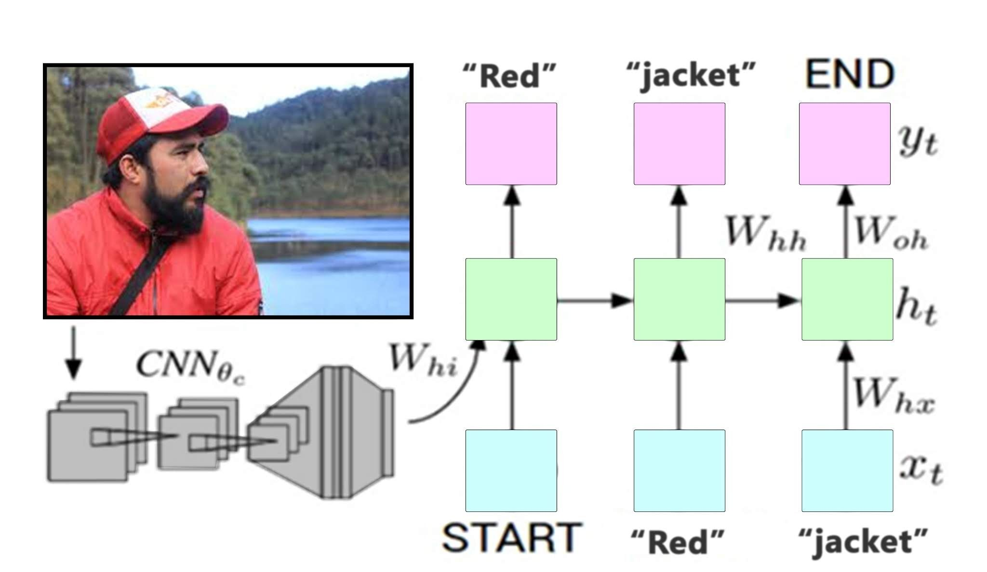
Transfer learning with CNNs is common
Classification loss, Bounding-box regression loss
Classification loss, Bounding-box regression loss
CNN pre-trained on ImageNet
Word vectors pretrained from word2vec
Object Detection Faster R-CNN
The Image Captioning problem CNN + RNN
Sources: Faster R-CNN: Towards Real-Time Object Detection with Region Proposal Networks, Ren, He et al. (2016)

Slide 36
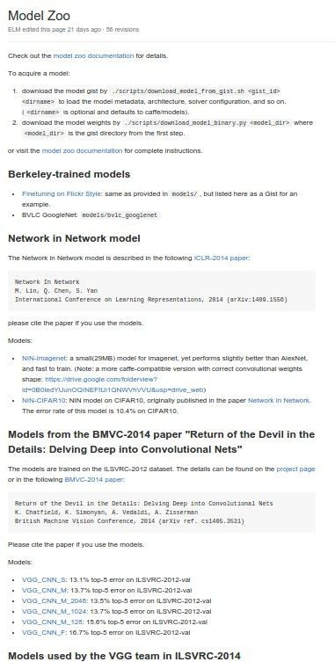
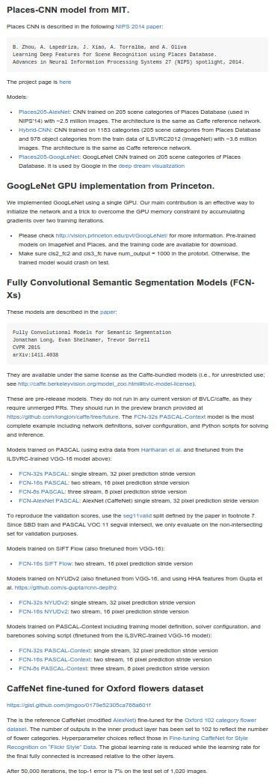
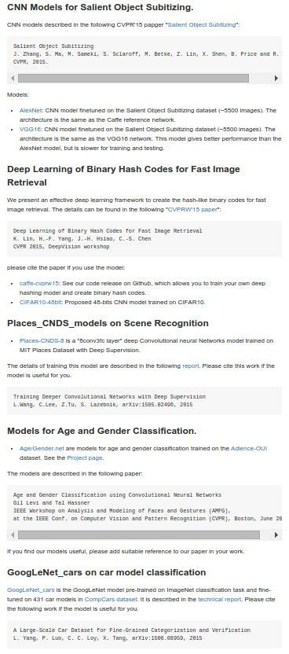
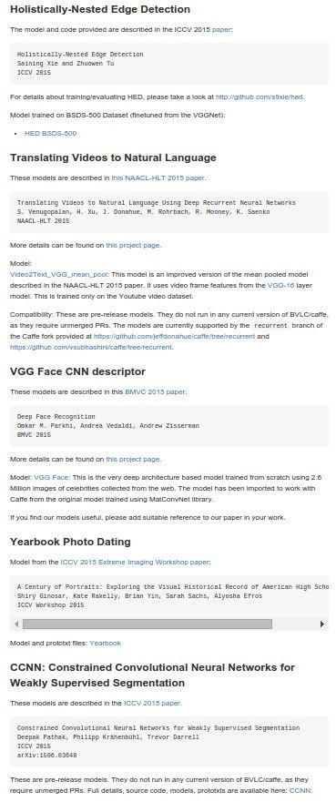
E.g. Caffe Model Zoo: Lots of pretrained ConvNets https://github.com/BVLC/caffe/wiki/Model-Zoo https://github.com/szagoruyko/loadcaffe
...

Slide 37
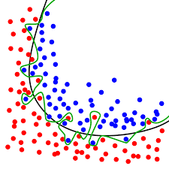
Overfitting in CNN
Neural networks are prone to overfitting because of the larger number of parameters.
CNN is able to model higher order and complex functions which makes it more prone to overfitting .

Slide 38
Solution to overfitting: Regularization

Slide 39

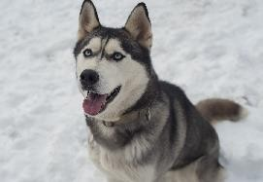
Regularization: Data Augmentation
Load image and label
“Dog”
Compute loss
CNN

Slide 40
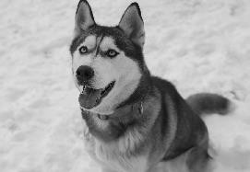
Regularization: Data Augmentation
Load image and label
“Dog”
Compute loss
CNN
Transform image

Slide 41
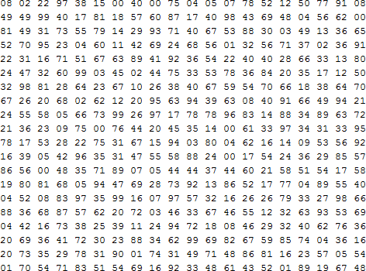
Regularization: Data Augmentation
What the computer sees

Slide 42
Data Augmentation
Horizontal flips
Rotation
Crop/Scale
Color Jitter
Other Creative Techniques

Slide 43
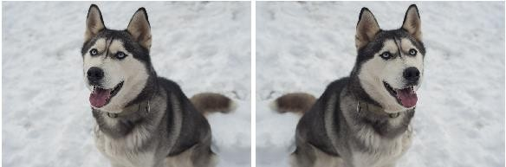
Data Augmentation
1. Horizontal flips
This scenario is important for the network to remove the bias of assuming that certain features of the object are available only on a particular side

Slide 44
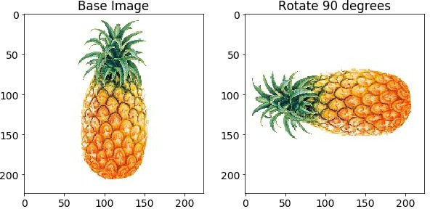
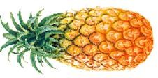
Data Augmentation
Rotations
The network has to recognize the object present in any orientation. Assuming the image is square, rotating the image at 90 degrees will not add any background noise in the image.
Depending upon the requirement, there may be a necessity to orient the object at minute angles. However the problem with this approach is, it will add background noise.

Slide 45
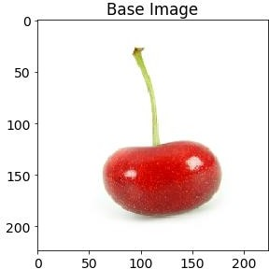
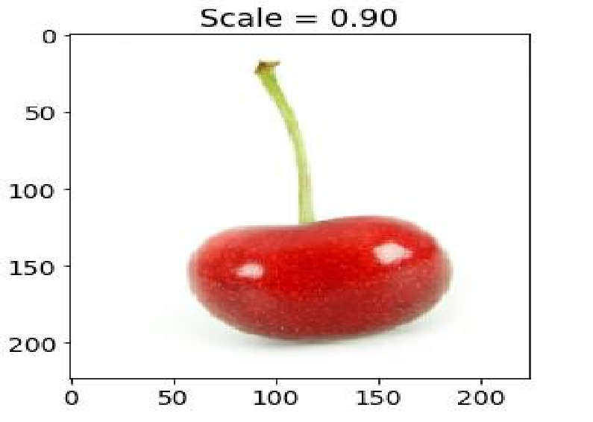
Data Augmentation
3. Random Cropping / Scaling
Scaling: The image can be scaled outward or inward. While scaling outward, the final image size will be larger than the original image size, and the opposite is true for inward scaling.
Image Example

Slide 46
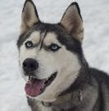
Data Augmentation
4. Random Cropping / Scaling
Cropping: Unlike scaling, we just randomly sample a section from the original image. We then resize this section to the original image size. This method is popularly known as random cropping.
Image Example

Slide 47

Data Augmentation
Simple:
Randomly jitter contrast
Complex:
Apply PCA to all [R, G, B] pixels in training set.
Sample a “color offset” along principal component directions.
Add offset to all pixels of a training image.

Slide 48
Data Augmentation
Other creative techniques
Random mix/combinations of :
translation (what about a pure ConvNet?)
rotation
stretching
shearing,
lens distortions, … (go crazy)

Slide 49

Data Augmentation
Training: Add random noise
Testing: Marginalize over the noise
Data Augmentation
Batch Normalization, Model Ensembles

Slide 50
Data Augmentation
Image Augmentation artificially creates training images through different ways of processing or combinations of multiple processing, such as random rotation, shifts, shear and flips.
Very easy to implement, gives good results especially on small datasets.
Easily fits into framework of noise / marginalization.

Slide 51
Guidelines for Batch Normalization
Batch Normalization (BN) may be used on the inputs to the layer before or after the activation function in the previous layer.
It may be more appropriate after the activation function if for s-shaped functions like the hyperbolic tangent and logistic function.
It may be appropriate before the activation function for activations that may result in non-Gaussian distributions like the rectified linear activation function, the modern default for most network types.
Using Batch Norm totally depends on the problem, it should be used when the absolute scale of the features does not matter.

Slide 52
Guidelines for Batch Normalization
Batch Normalization should be used deeper in the network.
Batch Normalization often leads to a worse performance when it’s combined with dropout, in both theoretical and statistical aspects.
Theoretically, Dropout shifts the variance of a specific neural unit when we transfer the state of that network from train to test.
However, BN would maintain its statistical variance, which is accumulated from the entire learning procedure, in the test phase.
The inconsistency of that variance (we call this the “variance shift”) causes the unstable numerical behavior in inference that finally leads to more erroneous predictions, when we apply Dropout before BN.

Slide 53
Why Batch Norm Works for ConvNets
Batch Normalization changes the absolute scale of the features according to the batch statistics, which is a random variable, while the relative distances between features are preserved.
This is completely fine for classification and segmentation tasks, where semantics of the image are invariant to arbitrary scaling and shifting of the channel values.

Slide 54
Why Batch Norm Works for ConvNets
Let’s say for example, you run a batch of images of dogs and cats through Batch Norm. The absolute color information is lost, but the dogs will still look like dogs and cats will still look like cats.
The important information in the image data that distinguishes cats from dogs is preserved and the images can still be classified or segmented.
So in a dog/cat classification problem, as long as the features from an image of a dog remain more “dog-like” than “cat-like” after Batch Normalization, we do not worry too much about absolute level of dog-likeness.

